Slide 1
FORMULA-1 RACE OUTCOMES PREDICTION
- Suchitra Hole, Yogita Bisht

Slide 2
PROJECT OVERVIEW
Our project focuses on utilizing historical data to forecast Formula 1 race outcomes for the years 2017 to 2023 (test data).
We aim to address two main questions:
Podium Predictions: Who are the top contenders for podium finishes (top 3 positions) in each race?
Constructors Championship: Which three teams are the frontrunners for the constructors' title?
Tools used : Python Jupyter Notebook, DB Browser for SQLite (DB4S)

Slide 3
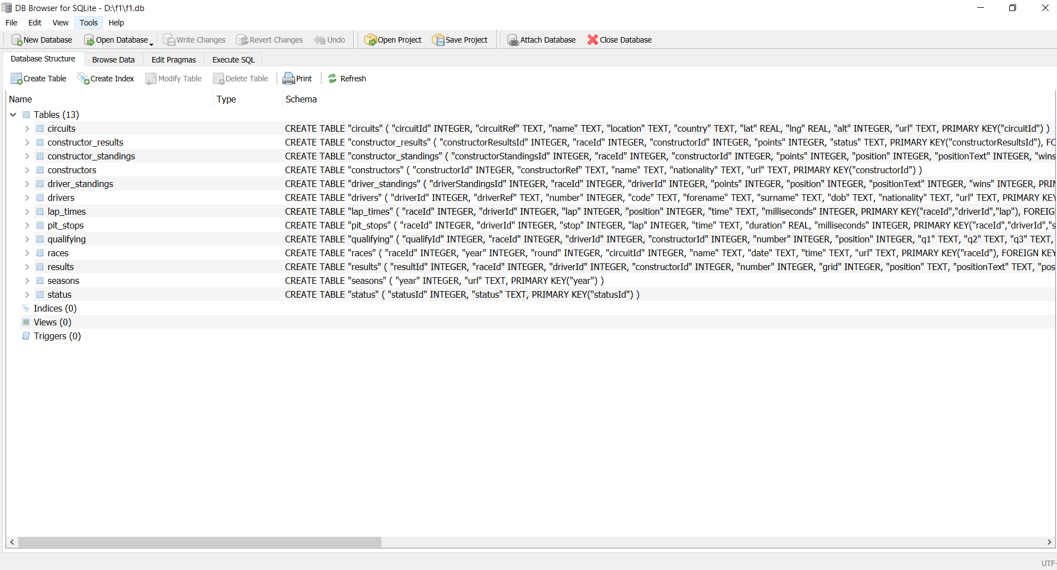
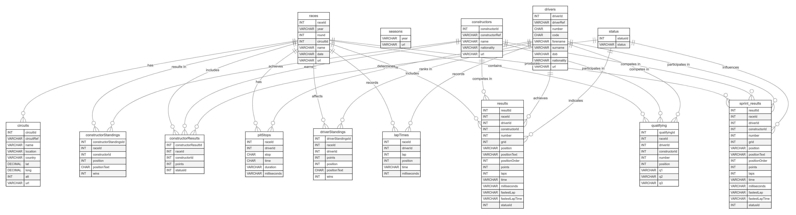
DATABASE SCHEMA
The schema comprises of the following tables that capture various aspects of Formula 1 racing:

Slide 4
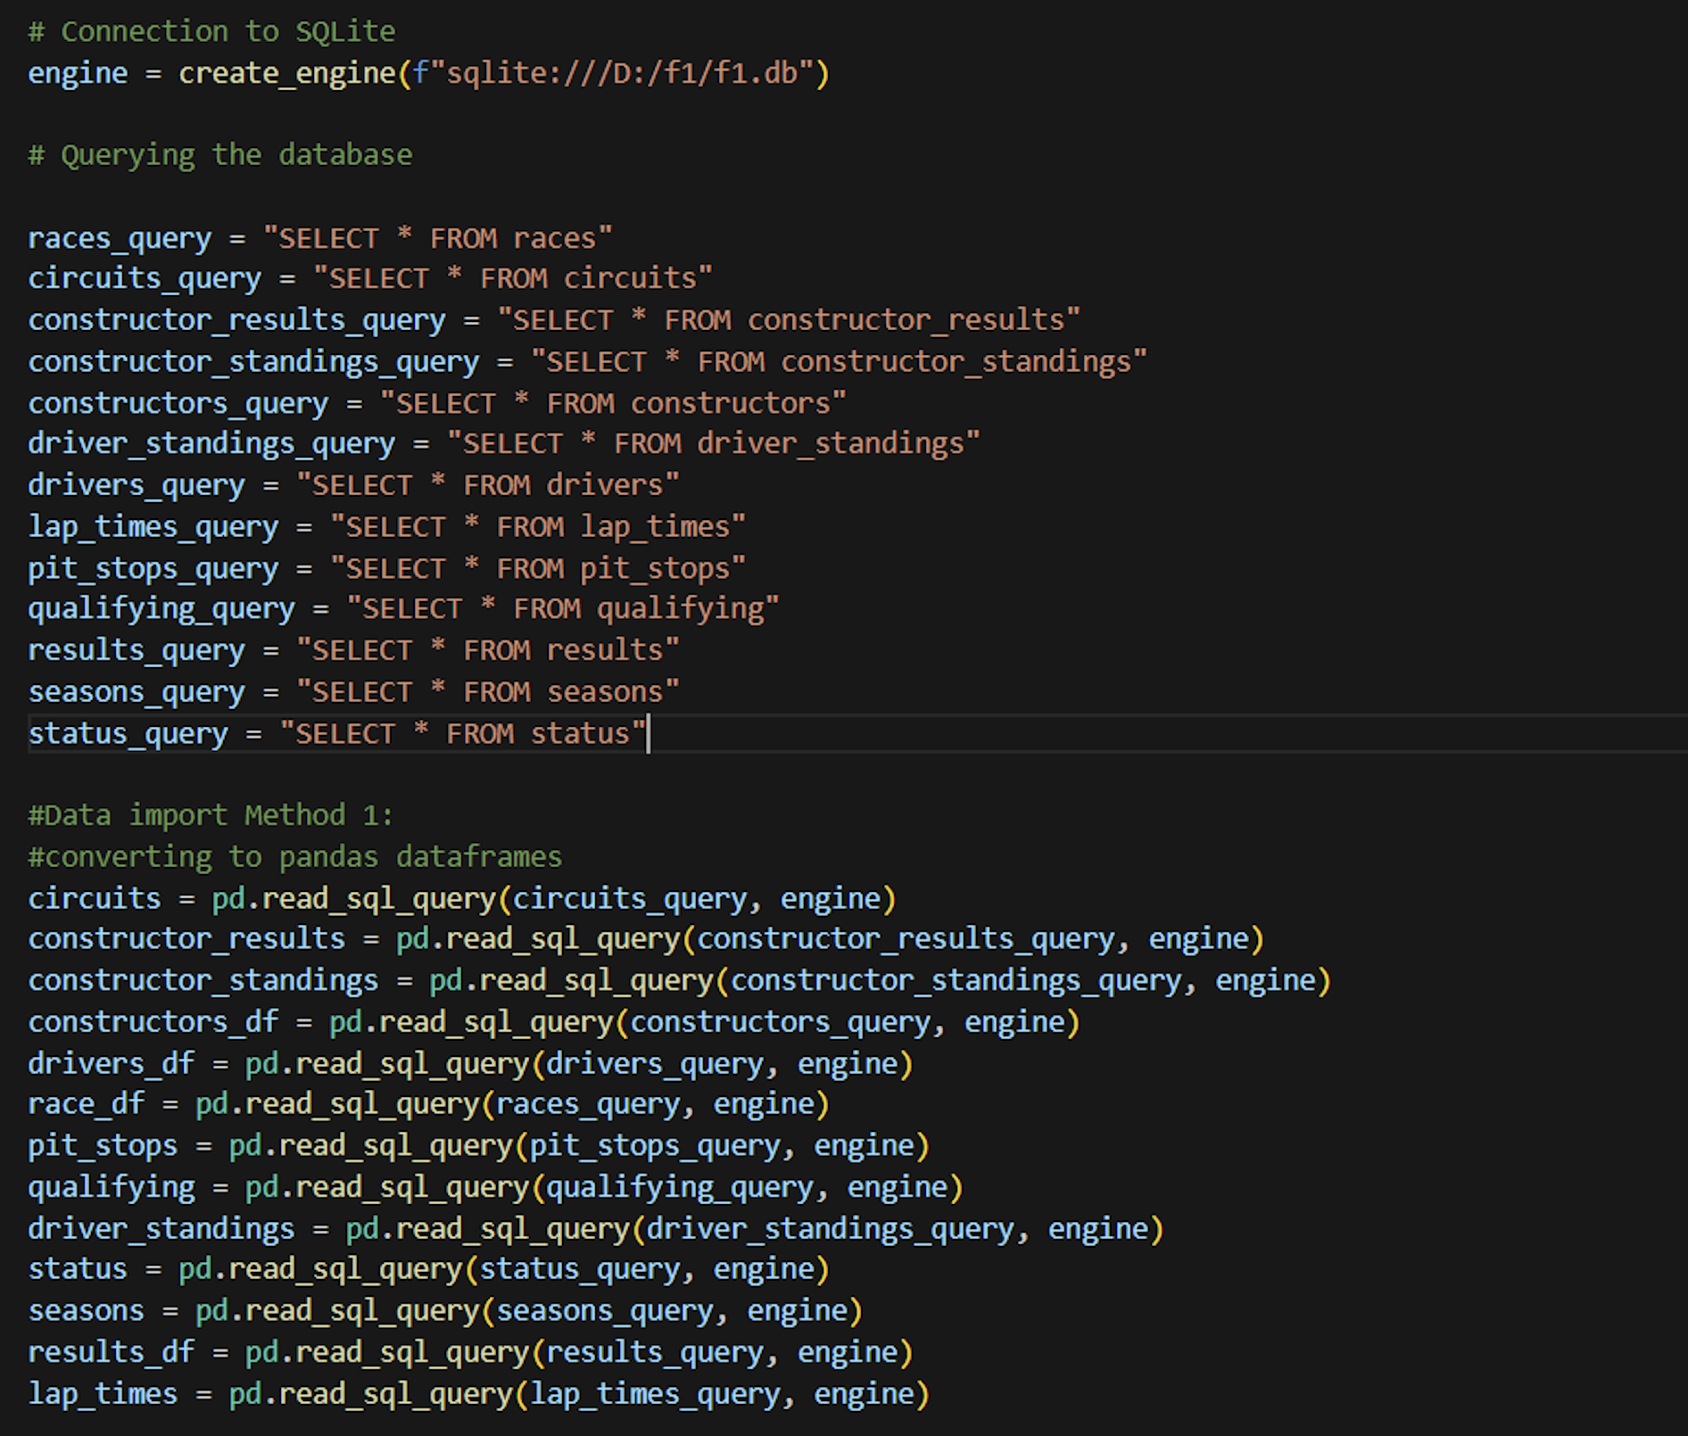
DATABASE CONNECTION

Slide 5
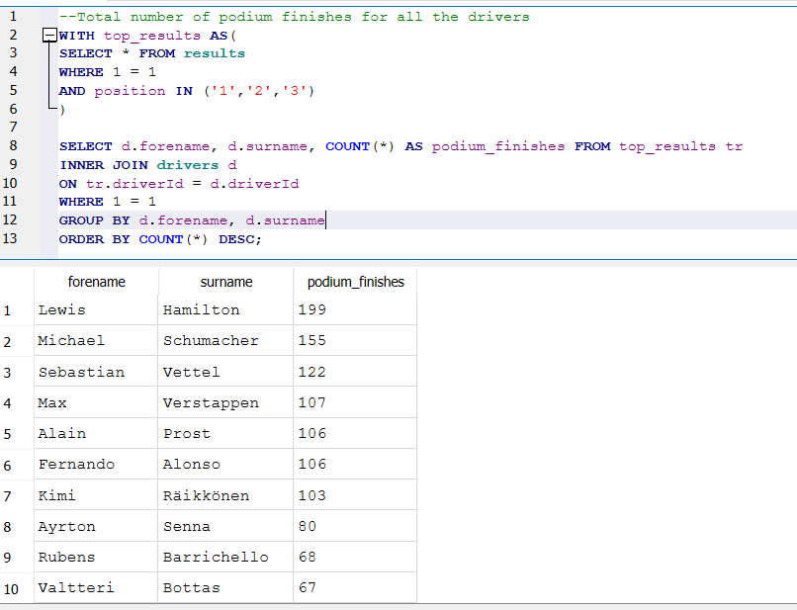
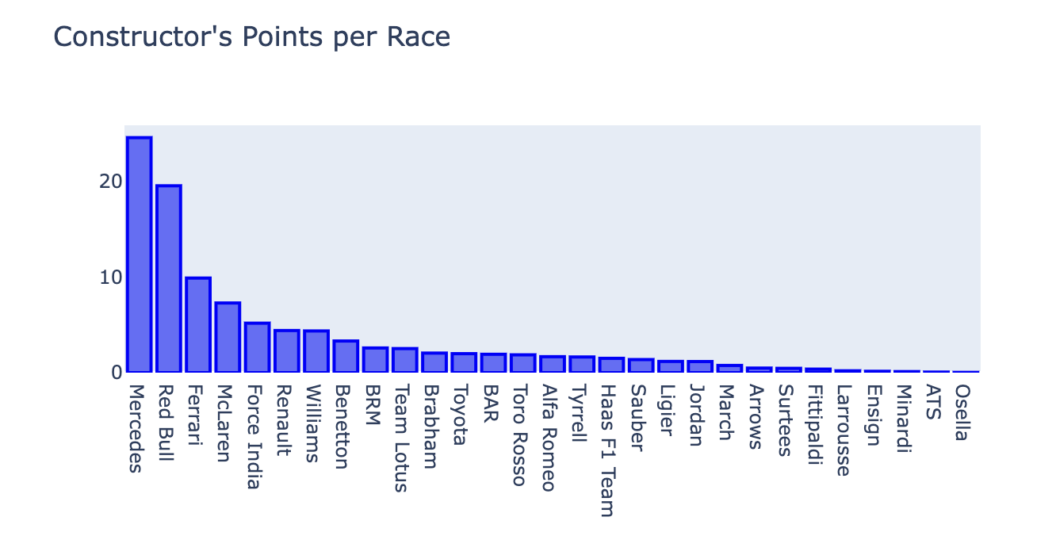
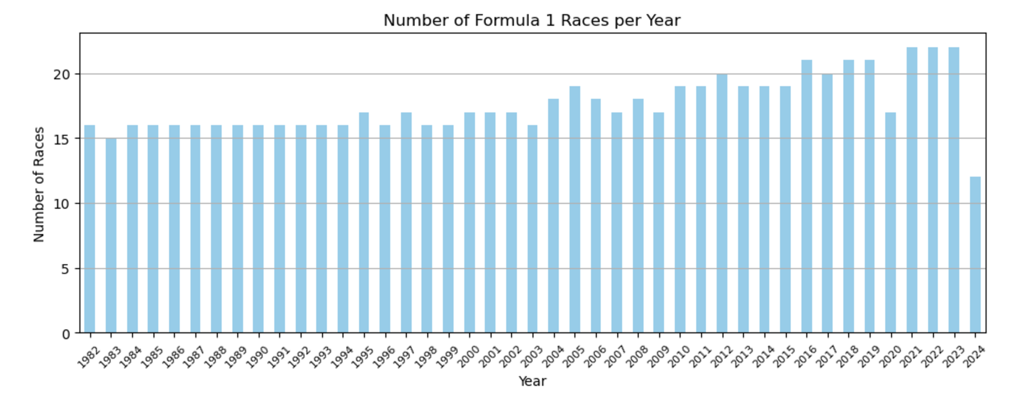
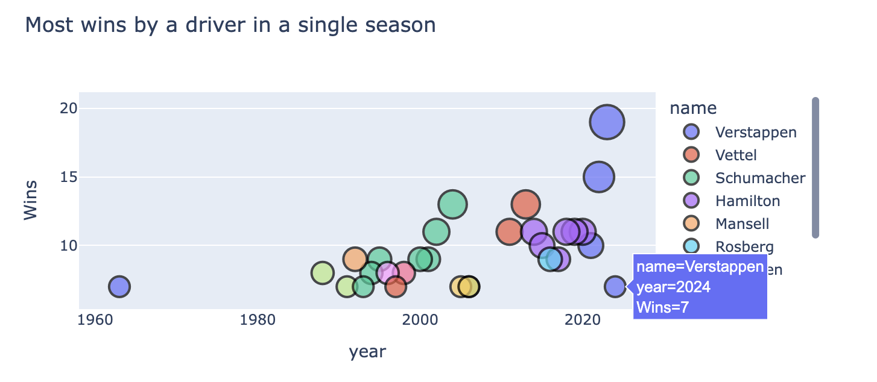
EDA

Slide 6
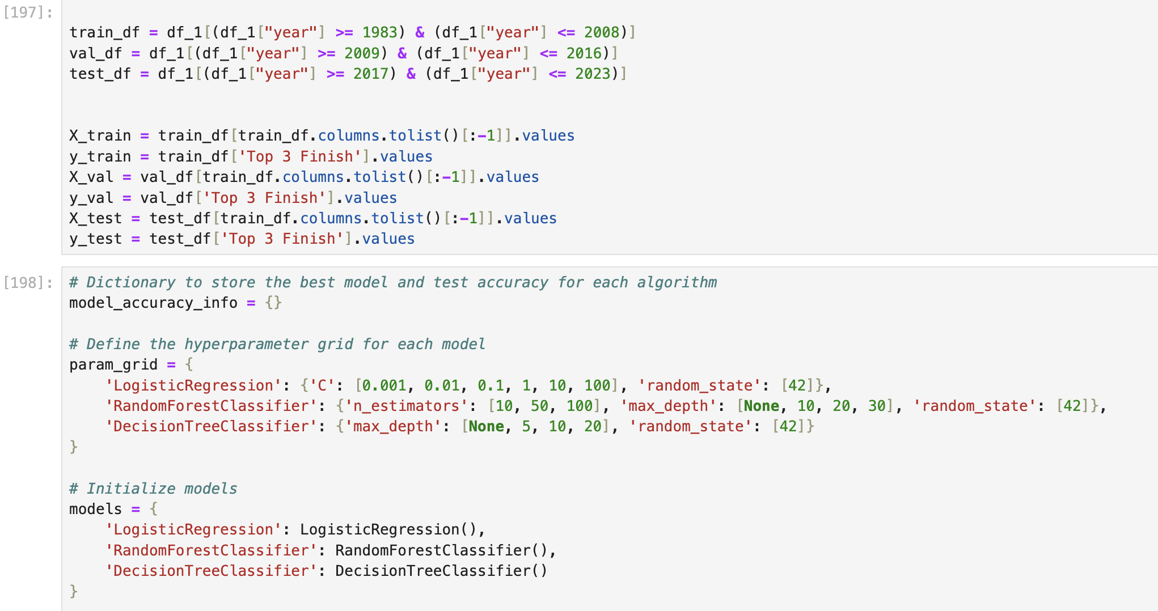
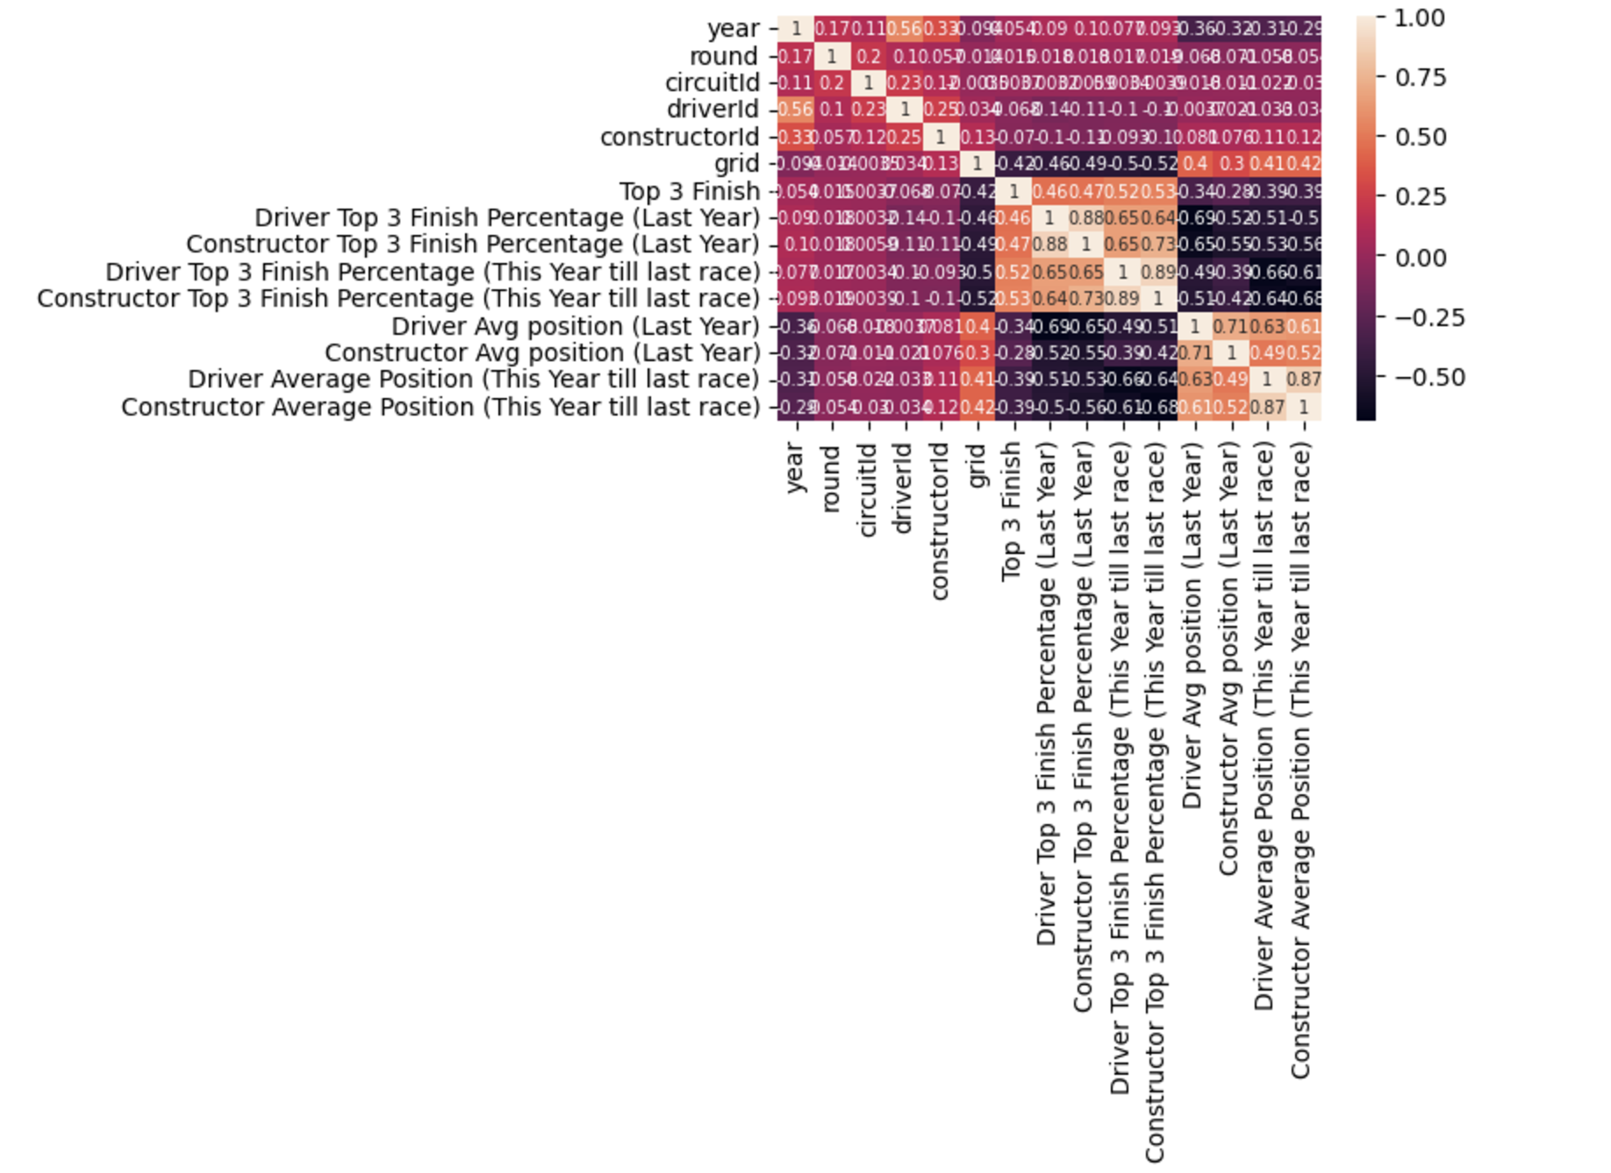
Model Training And Validation
Selected features from the original dataframe: raceId, driverId, constructorId, grid (starting postion), positionOrder (finishing position)
Conducted feature engineering to extract and refine key features for model training.
Split the dataset into training, testing, and validation sets, stratified by year.
Evaluated three machine learning models: Logistic Regression, Random Forest, and Decision Tree Classifier.

Slide 7
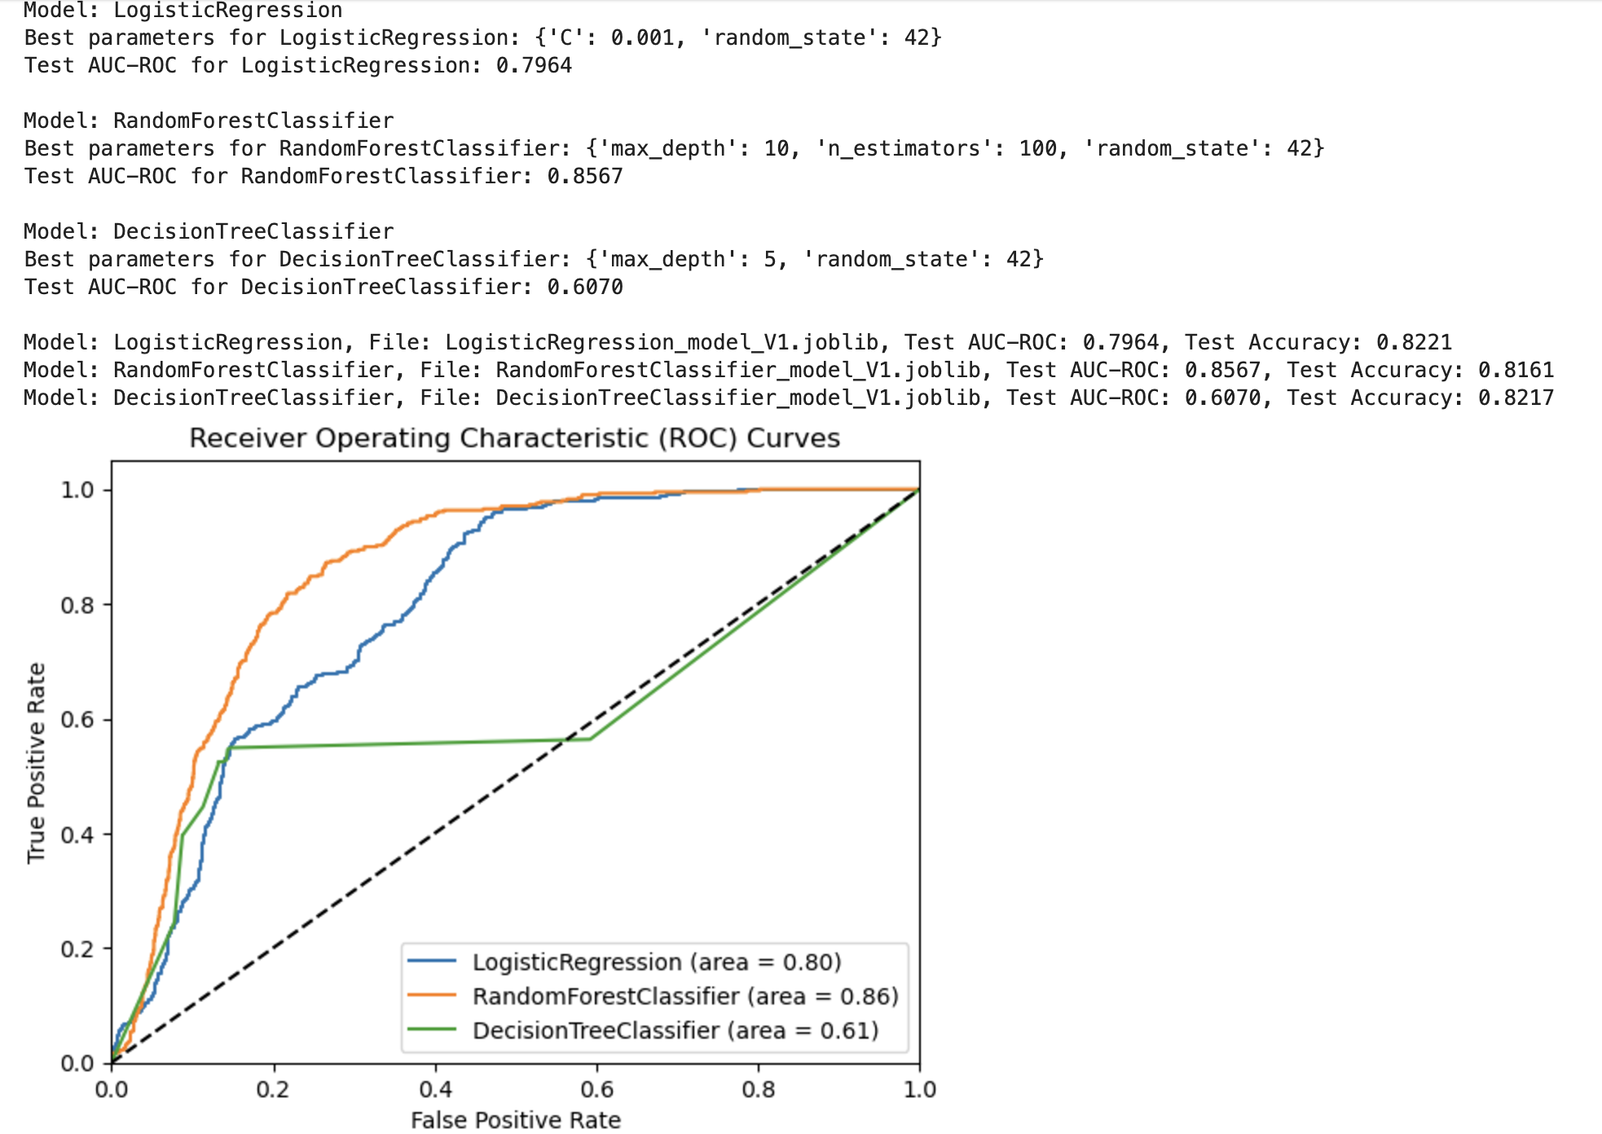
Results And Analysis
The Random Forest Classifier performs best with an area of 0.86, followed by Logistic Regression with 0.80, while the Decision Tree Classifier shows the poorest performance with an area of 0.61.
The model can be used to predict race outcomes, identify potential podium contenders, and assess team performance. This enables stakeholders, such as fans, teams, and sponsors, to make informed decisions based on these insights.

